Slide 1
HeapSort
Data Structure and Algorithm
Created By - Arnav Saraf

Slide 2
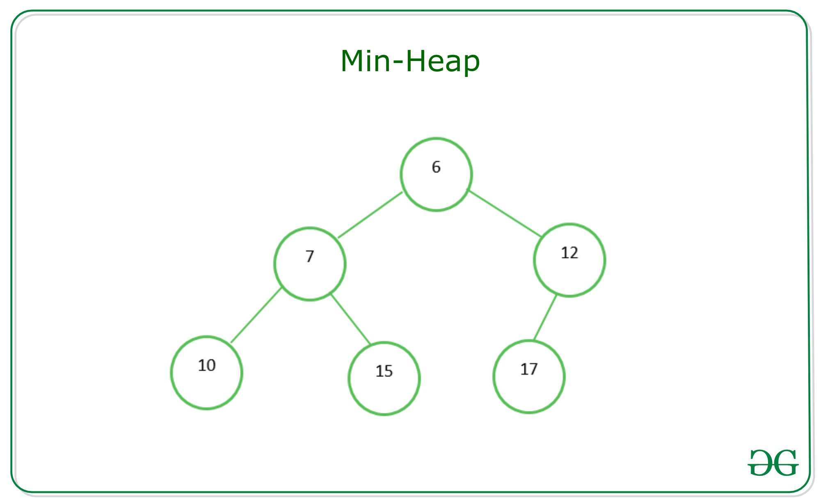
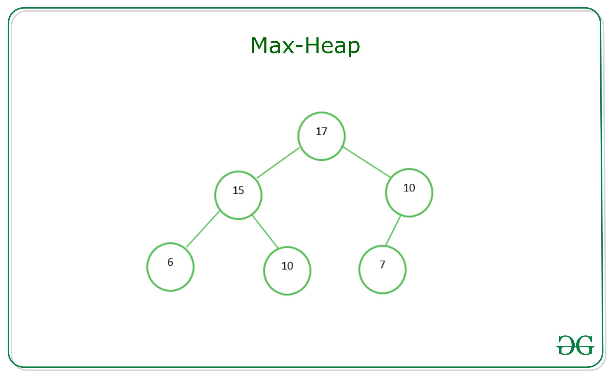
Brief on the Heap Data Structure
A heap is a specialized tree-based data structure that is commonly used to implement sorting algorithm, priority queues, and other application of efficient retrieval of minimum or maximum element.
Types of Heaps
Min-Heap
Max-Heap

Slide 3
How to create a MinHeap or a MaxHeap ?
We start with an unsorted array
Identify the last non-lead node
Recursively Heapify from bottom to the top
Let's look at an example [3, 9, 2, 1, 4, 5]
The last non-leaf node will be at (n/2)-1
Heapify at that node. Perform swap if necessary
Continue Heapifying recursively for all index smaller than leafnode
[3, 9 , 2, 1, 4, 5] → [3, 9, 5, 1, 4, 2] → [9, 3, 5, 1, 4, 2] → [9, 4, 5, 1, 3, 2]

Slide 4
Essential functions required for the algorithm to work
Heapify - This function ensures that a subtree rooted at a given node maintains the heap property (max-heap or min-heap)
Build Heap - This function constructs a heap from an unordered array using the Heapify function
Heapsort - This function sorts the array by repeatedly extracting the maximum (or minimum) element from the heap and re-heapifying the remaining elements.

Slide 5
The Sorting Algorithm
Create a MinHeap or MaxHeap
Extract the minimum or the maximum element repeatedly and place it in a sorted array
Swap the root node with the lowest/highest value
For better understanding we will visualize an unsorted array an go through the algorithm while sorting the array

Slide 6
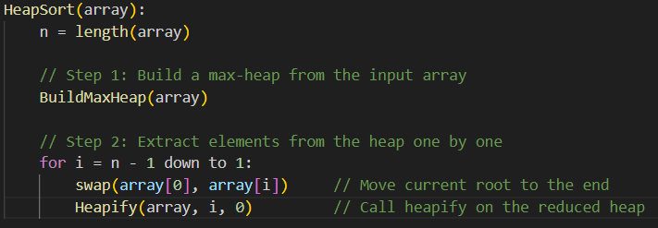
Implementation of a MinHeap/MaxHeap in C++
Heapsort Function -

Slide 7
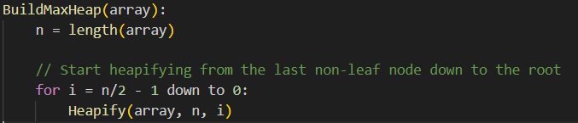
Implementation of a MinHeap/MaxHeap in C++
Build Heap -

Slide 8
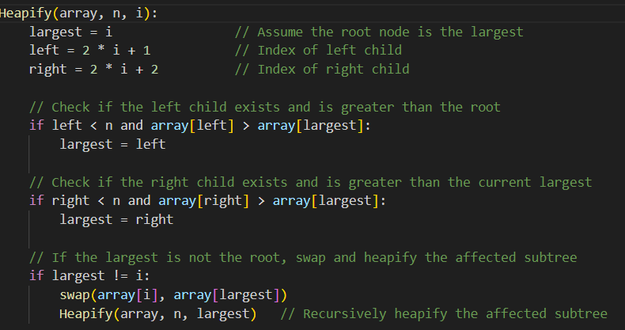
Implementation of a MinHeap/MaxHeap in C++
Heapify Function -

Slide 9
Time Complexity of the Algorithm
To calculate time complexity we will look at each of the three functions
Heapify - In the worst case scenario the heapify function may need to traverse from the root down to the lowest leaf node. For a tree with ‘n’ nodes this will take O(log n)
BuildHeap - Time complexity for BuildHeap is O(n)
HeapSort - Since there are n elements and each extraction costs O(log n) the time complexity of heapSort is n*O(log n) which is O(n log n)

Slide 10
Practice Question
Perform heapsort on the array [4, 8, 9, 3, 2, 5, 7, 1]

